Slide 1

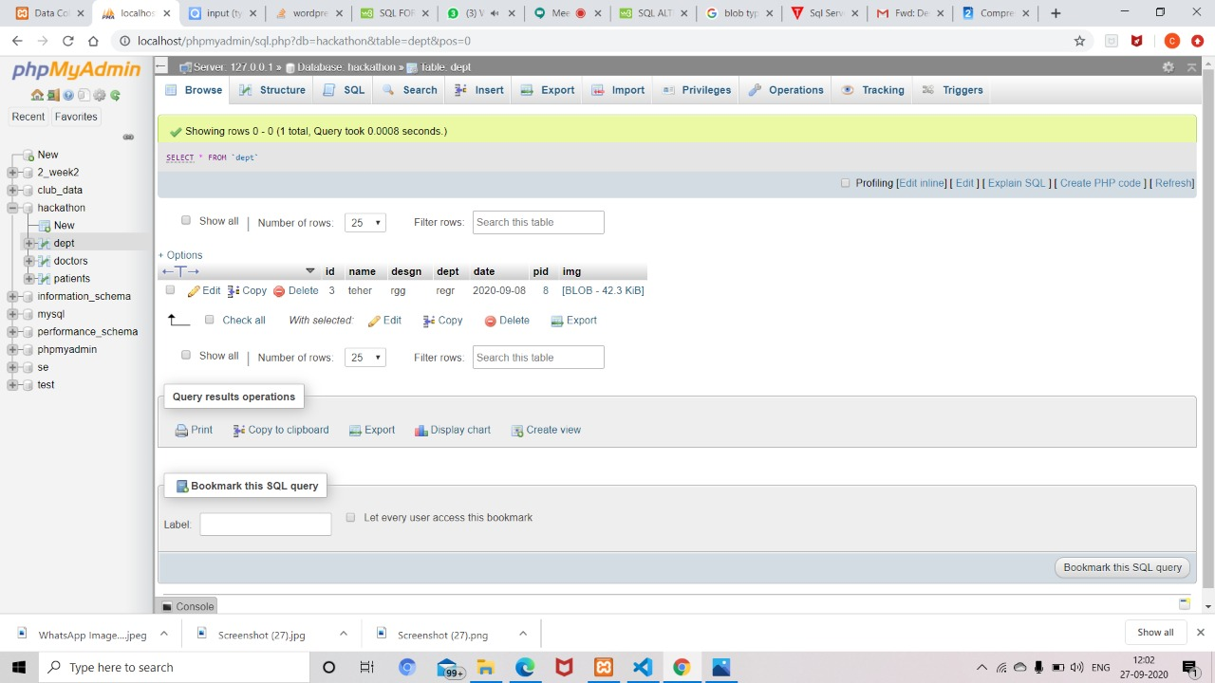
Project DocResearch
Problem statement and
solution proposal
BY TEAM WAYNE:
Varun Awati
Unnathi Javali
Sushanth B Patil
Meghana N

Slide 2
Outline
The Problem
Solution Proposal
Wireframes
Next Steps

Slide 3
The Problem

Slide 4
Problem statement
An Application which is an Replacement of the conventional method of data collection by Doctors
Conventional data collection method involves a lot of time and money. Delay in this process can directly affect the whole research and in turn it affects the entire patient community.
Notes:
Just tell about the problem statements in detail

Slide 5
What Doctors do Presently??
We as a team have giving a sincere effort in solving this problem in a limited time efficiently!!
Presently doctors or the hospital management are facing a lot of problems in the management of the patients database.some of the smaller hospitals are still using conventional paper-pen method to keep the record of the patients which brings a direct effect on the research and adversely effect on patient community as well.

Slide 6
Supporting information
Information has been the key to a better organization and new developments. The more information we have, the more optimally we can organize ourselves to deliver the best outcomes. That is why data collection is an important part for every organization. We can also use this data for the prediction of current trends of certain parameters and future events.
1
Link of the Big Data Analytics of the Problem Statement:
https://journalofbigdata.springeropen.com/articles/10.1186/s40537-019-0217-0

Slide 7
Why Regarding Healthcare??
Healthcare is a multi-dimensional system established with the sole aim for the prevention, diagnosis, and treatment of health-related issues or impairments in human beings. The major components of a healthcare system are the health professionals (physicians or nurses), health facilities (clinics, hospitals for delivering medicines and other diagnosis or treatment technologies), and a financing institution supporting the former two.

Slide 8
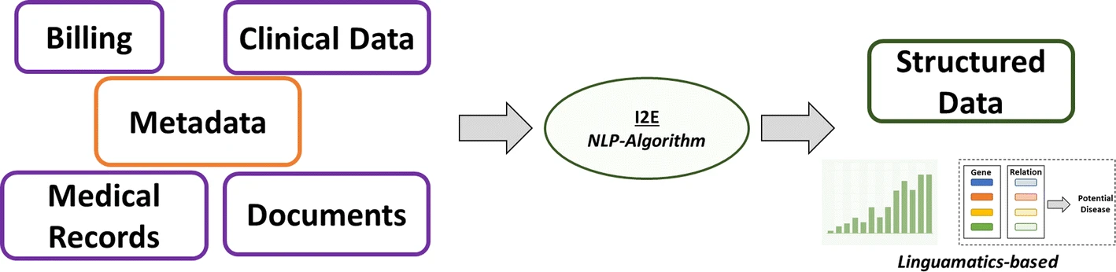
Referential Representation for the Supporting Info

Slide 9
Source of the Problem Statement:
We have been given the problem statement stating some of the requirements of the project from the Deshpande Foundations conducted Virtual Hackathon.
In this problem statement we were asked to create a dynamic platform for the doctors to fill the information of the patients they treat digitally without the use of the conventional method i.e Pen-Paper based record maintaining.
So we as the team have given our sincere effort in meeting the expectations of the respected foundations and the competition by our work.

Slide 10
Solution Proposal

Slide 11
Solution description
We have designed a solution for the problem statement mentioned as we as a team have created a web application which gives a dynamic platform to the doctors through which they can maintain a database of their patients in a more efficient manner

Slide 12
Wireframes

Slide 13
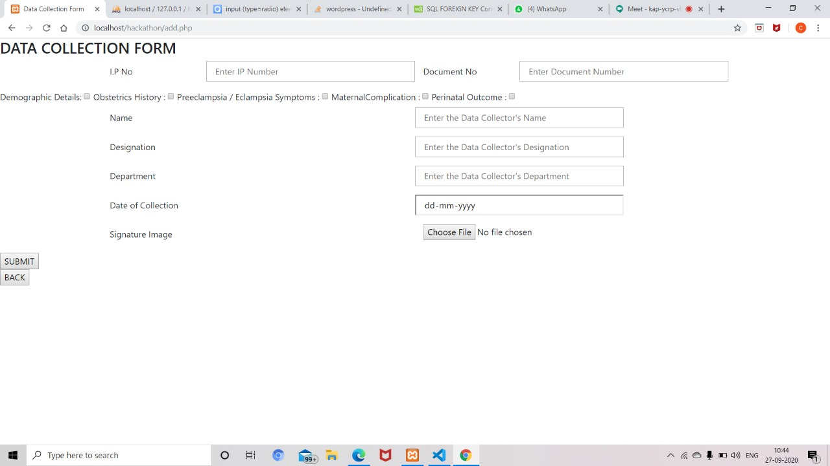

Information architecture
Balsamiq Tip | Information architecture is the flow of content across the site or application (more info).

Slide 14
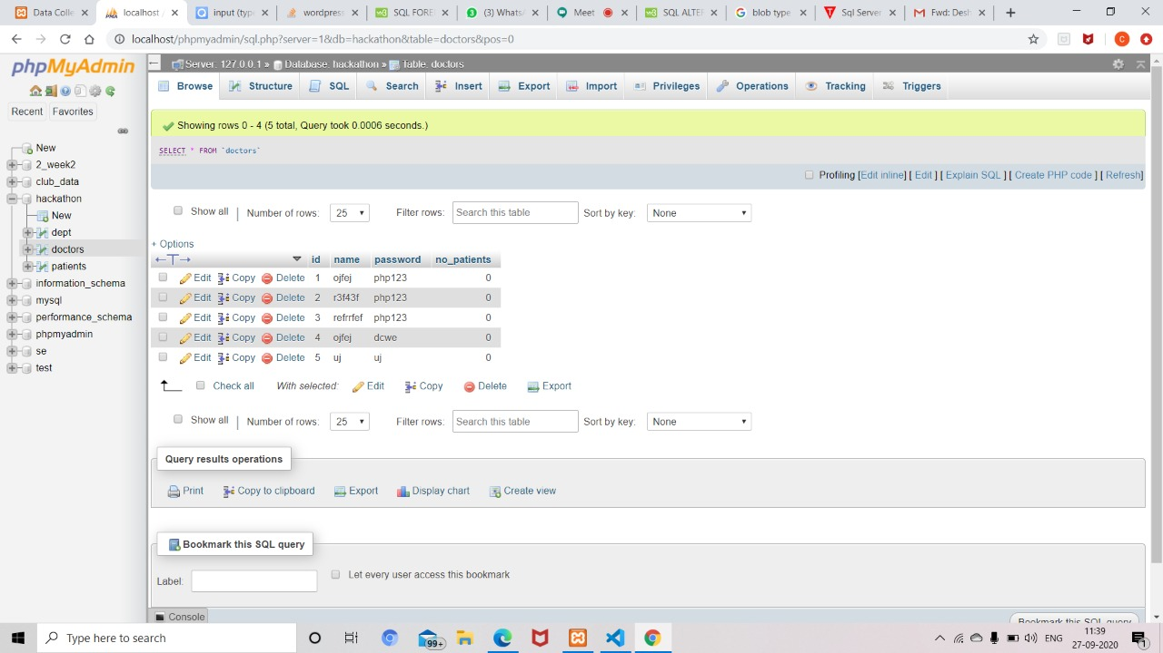
Component Browser
DataBase of the web application:Doctors Table
Balsamiq Tip | Use the Balsamiq add-on to make your own wireframe.

Slide 15
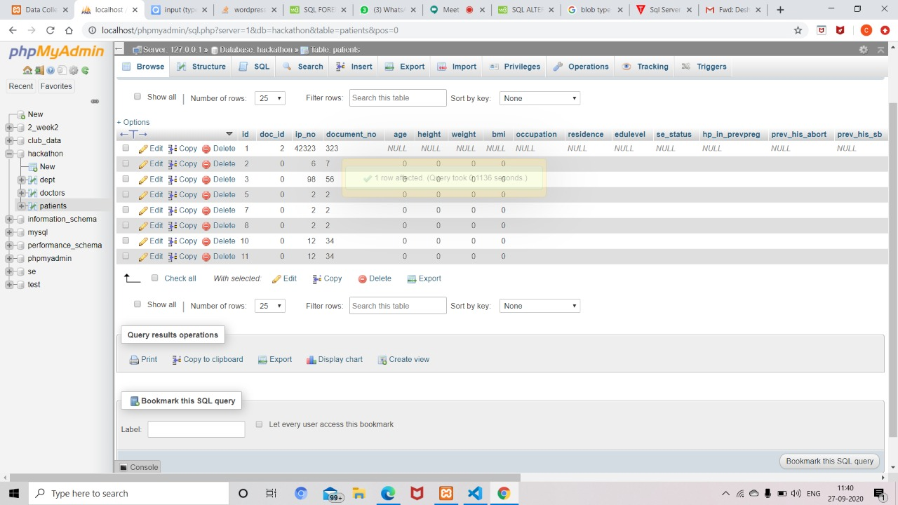
DataBase of the Web application:Patients Table

Slide 16
Department Database

Slide 17
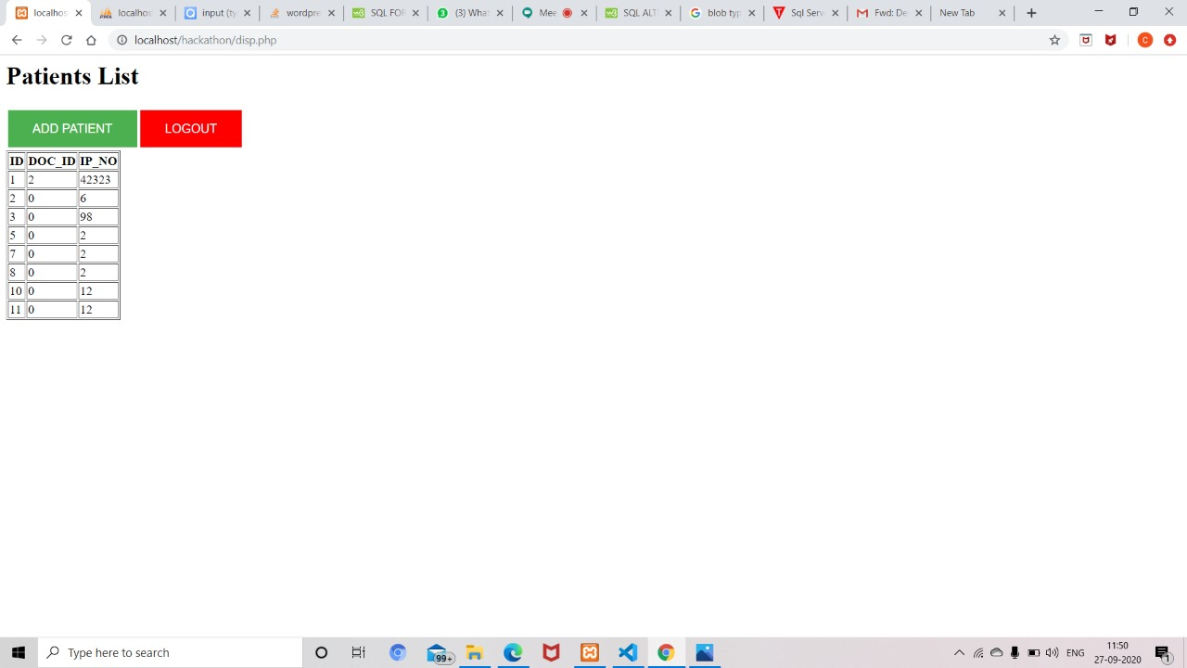
Patients List of the Doctors

Slide 18
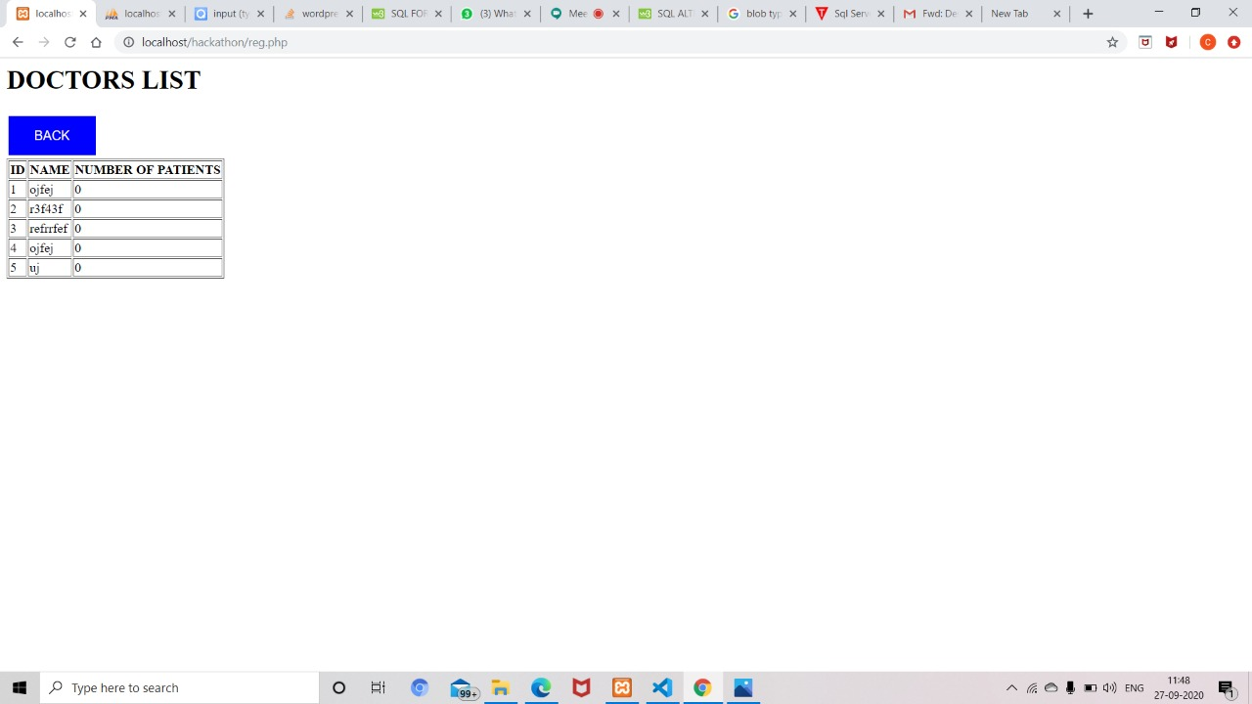
Doctors List from Admin

Slide 19
Questions?

Slide 20
References
We have taken in some of the information from this analysis….
https://journalofbigdata.springeropen.com/articles/10.1186/s40537-019-0217-0

Slide 21
Thank You

